Slide 1

CREDIT CARD USERS CHURN PREDICTION
ML Fridays
Fraud Detection using Deep Graph Networks
Arun Kumar Lokanatha – AI/ML solution architect Date – 09/04/2021

Slide 2
ABSTRACT
As we are moving towards the digital world — People should be aware of all the benefits and necessities of using credit card. Credit cards can be used for high transactions and they follow the process “Use now and pay later”.
Every year, many customers buy credit cards, and many customers leave so we need to forecast future churn in the credit card company.
Credit card churn prediction can assist a bank to know which of his customer is going to renounce and can also assist the bank to know on which customer he needs to emphasize more so that he can earn the highest gains.
Future churn can be estimated by evaluating recent industry patterns and churn rate, as well as potential innovations.
Total transaction, Total transaction count, and total relationship count matters a lot in retaining the customer. The functionality is based on a website that recognizes customer requirements and then incorporates the use of data mining's multiple regression algorithm and Auto-ML. This study aims to use classification analysis and Auto-ML to predict Customer Churn based

Slide 3
OBJECTIVE
The main objective is to build a classification model that would help the bank and improve its services such that the customers do not renounce their credit cards.
Explore and visualize the dataset.
Build a classification model to predict if the customer is going to churn or not.
Optimize the model using appropriate techniques.
Generate a set of insights and recommendations that will help the bank in retaining its customers

Slide 4
Table of contents
Business Problem Overview
Exploratory Data Analysis (EDA)
Model Performance Summary
Business Insights and Recommendations

Slide 5


Business problem Overview
© 2020, Amazon Web Services, Inc. or its Affiliates.

Slide 6
Business problem Overview
The XYZ bank recently saw a steep decline in the number of users of their credit card, credit cards are a good source of income for banks because of different kinds of fees charged by the banks like annual fees, balance transfer fees, and cash advance fees, late payment fees, foreign transaction fees, and others.
Some fees are charged to every user irrespective of usage, while others are charged under specified circumstances.
Customers’ leaving credit cards services would lead bank to loss, so the bank wants to analyse the data of customers’ and identify the customers who will leave their credit card services and reason for same, so that bank could improve upon those areas
We’ll build different models and use appropriate techniques to get a final model that will help the bank predict which customers have a higher chance of leaving the bank services

Slide 7
Exploratory Data Analysis
© 2020, Amazon Web Services, Inc. or its Affiliates.

Slide 8
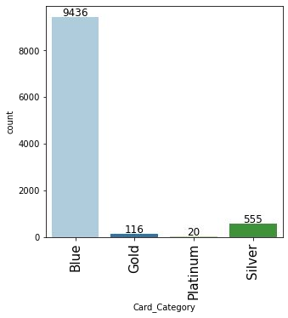
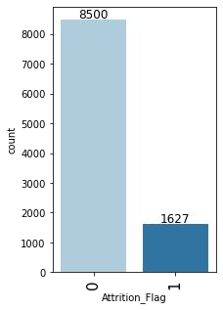
Exploratory Data Analysis
93.2% of the customers have a Blue card.
The Blue card would be a standard card given by the bank to all its customers.
16.2% of the customers attrited.
This indicates an imbalance in the data.

Slide 9
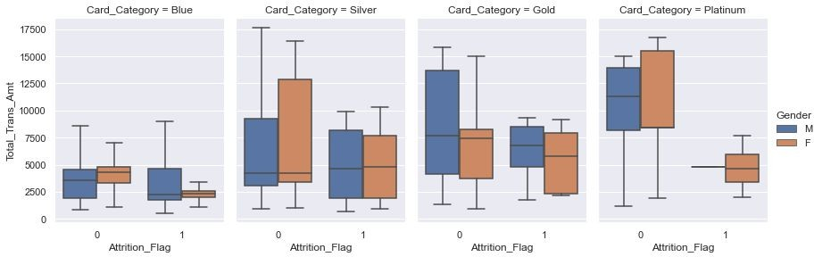
Exploratory Data Analysis
Blue Card
Female customers have higher total transaction amounts, for existing customers. Those female customers who spent less than 5000 using the blue cards attrited.
Silver Card
There's not much difference between attrited and not-attrited customers or make and female customers.
Customers spending less than 10,000 attrited.
Gold Card
The spending for both male and female customers is the same. Customers spending less than 9000 attritted.
Platinum Card
Both males and females have equal spendings. Those customers who spent less than 7500 attrited.

Slide 10
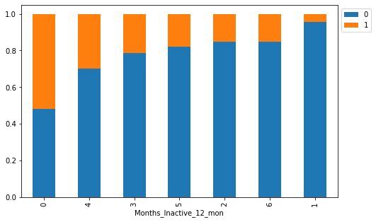
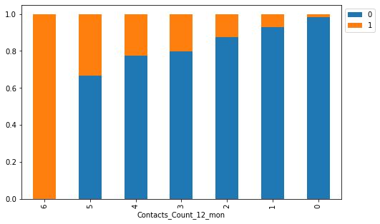
Exploratory Data Analysis
As inactivity increases attribution also increases(2-4 Months).
The interpretation from here for 0 months and 6 months is difficult as the customers who recently used the card attrited the most while those who were inactive for 6 months attrited less.
The highest attrition is among the customers who interacted the most with the bank.
This signifies that the bank is not able to resolve the problems faced the customers leading to attrition.
A preliminary step to identify the attriting customers would be to look out for customers who have reached out them repeatedly.

Slide 11
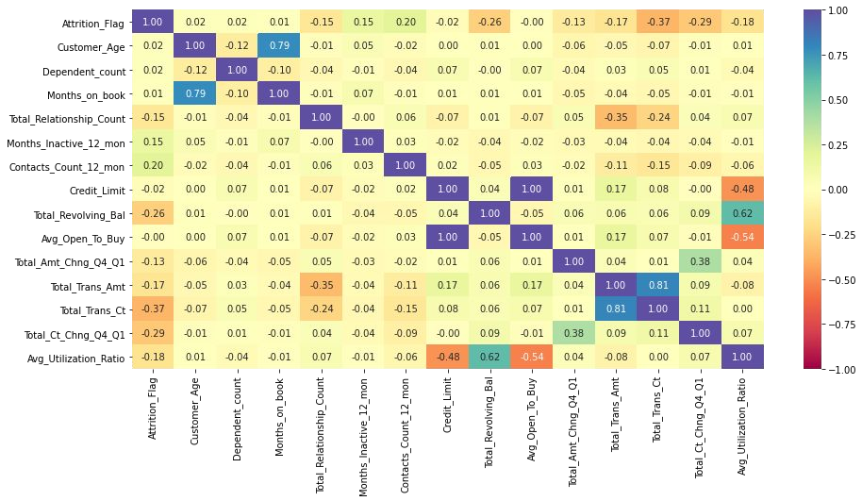
Exploratory Data Analysis
The attrition flag shows a bit of a negative correlation with total transactions count and total transaction amount
There's a strong positive correlation between months on book and customer age, total revolving_Bal and Avg utilization ratio, total trans amt and Total trans count
There's a negative correlation of Total relationship count with the total trans amt and total trans count, avg utilization ratio with the credit limit and avg open to buy.

Slide 12
Model Building
© 2020, Amazon Web Services, Inc. or its Affiliates.

Slide 13
Model Building - steps
Split the dataset into train, test and validation sets
Impute missing values using mode
Choose Model performance evaluation metric
Build different models - Logistic Regression,DecisionTreeClassifier, RandomForestClassifier, BaggingClassifier, AdaBoostClassifier, GradientBoostingClassifier, XGBClassifier
Build different models on undersampled data
Build different models on oversampled data
Tune hyperparameters using RandomSearchCV
Compare all models’ performance on train and validation data
Choose a final model and find the performance on test data
At last create a pipeline to productionize the final model

Slide 14
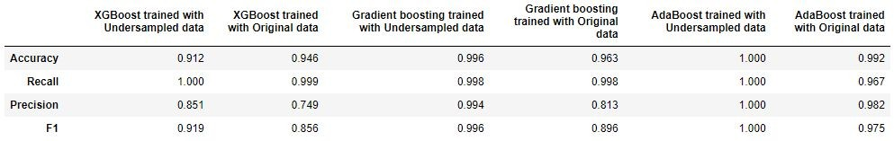
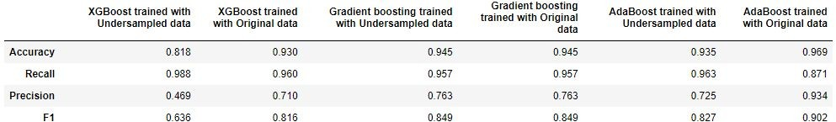
Comparing Model Performance
Training Performance
Validating-Performance
Gradient boosting model trained with original data has generalised performance, so let's consider it as the best model.

Slide 15
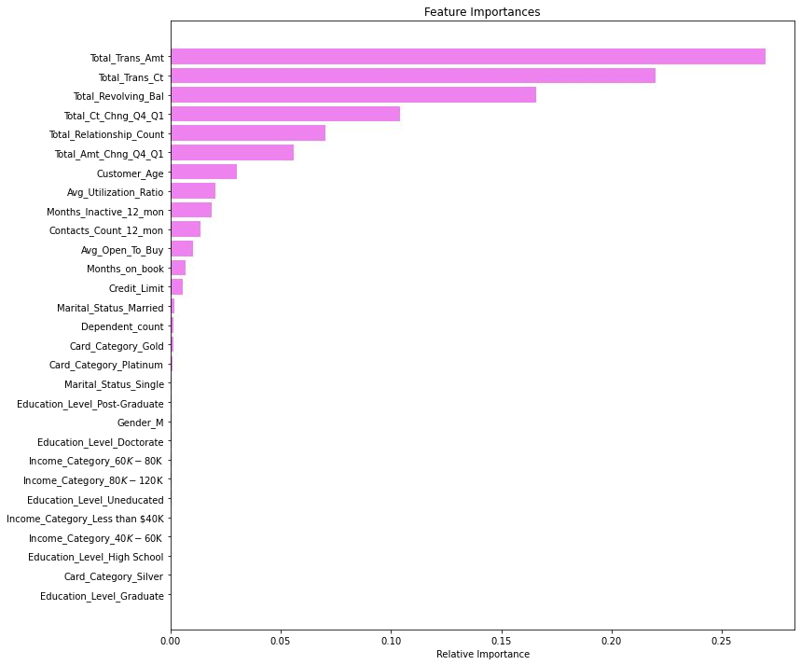
Feature Importance
Total_Trans_Amt is the most important variable in predicting credit card churn followed by Total_Revolving_Bal, Total_Trans_Ct, Total_Relationship_Count, and Total_Ct_Chng_Q4_Q1.

Slide 16
Business Insights and Recommendations
© 2020, Amazon Web Services, Inc. or its Affiliates.

Slide 17
Business Insights and Recommendations
Factors that drive the attrition - Total_Trans_Ct, Total_Revolving_Bal, Total_Trans_Amt, Total_Relationship_Count
Total_Trans_Ct: Less number of transactions in a year leads to attrition of a customer -
  a) To increase the usage of cards the bank can provide offers like cashback, special discounts on the purchase of something, etc so that customers feel motivated to use their cards.
  b) The cards can be made flexible for transactions so that customers can use them at more places (like shops, malls, etc).
Total_Revolving_Bal: Customers with less total revolving balance are the ones who attrited, such customers must have cleared their dues and opted out of the credit card service. The bank should investigate it further to find the cause
Total_Trans_Amt: Less number of transactions can lead to less transaction amount and eventually leads to customer attrition - Bank can provide offers on the purchase of costlier items which inturn will benefit the customers and bank both.

Slide 18
Business Insights and Recommendations(cont.)
Total_Relationship_Count: Attrition is highest among the customers who are using 1 or 2 products offered by the bank - together they constitute ~55% of the attrition - Bank should investigate here to find the problems customers are facing with these products, customer support, or more transparency can help in retaining customers.
Female customers should be the target customers for any kind of marketing campaign as they are the ones who utilize their credits, make more and higher amount transactions. But their credit limit is less so increasing the credit limit for such customers can profit the bank.
Months_Inactive: As inactivity increases the attrition also increases, 2-4 months of inactivity are the biggest contributors of attrition -Bank can send automated messages to engage customers, these messages can be about their monthly activity, new offers or services, etc.
Highest attrition is among the customers who interacted the most with the bank, This indicates that the bank is not able to resolve the problems faced by customers leading to attrition - a feedback collection system can be set-up to check if the customers are satisfied with the resolution provided, if not, the bank should act upon it accordingly.

Slide 19
Resources
© 2020, Amazon Web Services, Inc. or its Affiliates.

Slide 20
Resources
Credit Card User Churn Prediction : Kaggle link
Mphasis machine learning solution For Credit Card Churn Prediction : Mphasis link
An Approach For Credit Card Churn Prediction Using Gradient Descent : Springer link

Slide 21

Thank You
© 2020, Amazon Web Services, Inc. or its Affiliates.

